Slide 1
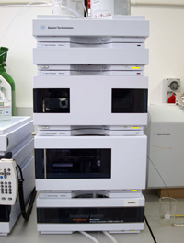
DEVELOPMENT OF A RP-HPLC METHOD FOR THE DETERMINATION OF METFORMIN IN HUMAN PLASMA
KISCOMS 5th International Congress of Medical Sciences 8-10 May 2015 Prishtina, Republic of Kosovo
Eva troja

Slide 2
Determination of metformin in biological fluids
(human plasma, urine, etc)
Challenge to conventional chromatographic methods

Slide 3
Metformin
Oral antidiabetic drug
Small molecule with high polarity
(impossible to maintain by RP columns)
pKa1=2.8 and pKa2=11.5

Slide 4
Determination of Metformin in plasma
There are many methods to determine Metformin in plasma :
LC-MS/MS
GC
Capillary electrophoresis
Cation-exchange HPLC
Normal phase chromatography
RP-HPLC (specific column or common columns using ion-pairing agent)

Slide 5
The purpose of the study
To developed a method using a conventional column

Slide 6
Ion-pairing chromatography

Slide 7
Sample preparation techniques – Advantages and Limitations
Protein precipitation or dilution
Easy
Not specific
Cost efficient
Extraction is necessary because:
Provides a purity of biological material to be injected
Enables analyte’s concentration
Solid phase extraction
Requires skilled operator
Specific
Less cost efficient when compared to protein precipitation or dilution methods
Liquid-liquid extraction
Requires skilled user
Specific
Less cost efficient when compared to protein precipitation or dilution methods

Slide 8
What do we want from our method ?
To be simple
To use conventional column
To be selective
To be accurate
To be rapid
To comply the purpose (study of BE from plasmatic data)

Slide 9
Materials and reagents
Metformin HCl
ACN (HPLC grade)
SDS, H3PO4 (analytical grade)
Millipore water (Direct Q-UV-Ultrapure® water system)
NYLON membrane filters type HNWP (47mm, 0.45µm)

Slide 10
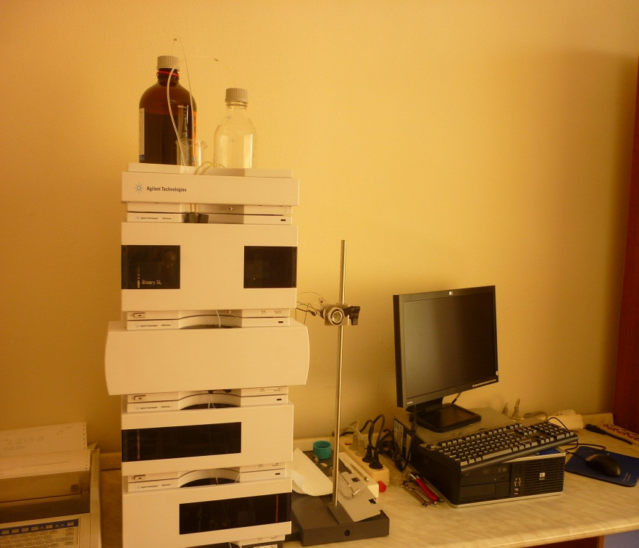
Instruments/Chromatographic system
Chromatographic system in reverse phase Agilent 1200, having in-built binary pump, UV/Vis DAD (Agilent 1200) using CWS software (ChemStation) install in PC.
LiChrocart ® 100 RP 18 (125mm x 4.0mm i.d., 5µm particle size) C18.
Centrifuge
Analytical balance
Vortex
pH-meter
Ultrasonic cleaner

Slide 11
Chromatographic conditions
Mobile phase ACN:sodium phosphate buffer 10 mmol pH=6.0, 0.3%SDS (32.5:67.5)
Mobile phase was filtered and degased for 30 minutes before use.
The flow rate 1.25 ml/min, dedection was carry out in 236 nm
Column’s temperature 50°C
Manual injector 20µL
The retention time of metformin was 4 minutes
Method was linear in the range 50-1600 ng/ml.

Slide 12
Calibration standards and quality control plasma samples
Stock solution Metformin in buffer (500 µg/ml)
Working standards (1-50 µg/ml) obtained by diluting the stock solution in milliwater
The solutions were freshly prepared for each analytical run
Blood samples were centrifugated at 3500 rpm/min for 10 min
Protein precipitation and wash with dichloromethane

Slide 13
Development and validation of bioanalytical method
The main analytical parameters that are used for validation of bioanalytical method are :
Linearity
Precision
Accuracy
Limit of dedection
Limit of quantification
Selectivity
Specificity
Robustness

Slide 14
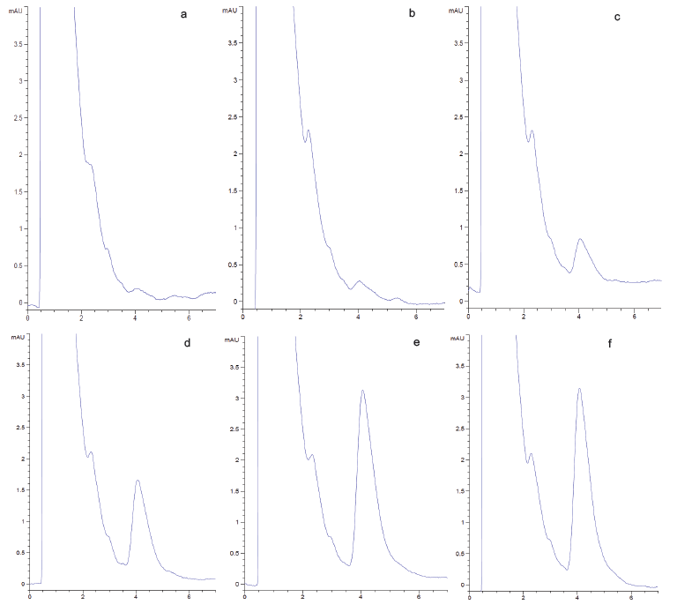
Linearity
Concentration of analyte– absorbance
Calibration curve of metformin in plasma
For research use only. Not for use in diagnostic procedures.
Fig 1. HPLC-UV chromatograms obtained for blank plasma spiked with metformin 50 ng/ml (a), 100 ng/ml (b), 300 ng/ml (c), 800 ng/ml (c), 1500 ng/ml (d), 1600 ng/ml (f).

Slide 15
Metformin Calibration Curves
a) b)
Fig 2. Calibration curves of metformin in plasma within-day (a) and between days (b).

Slide 16
Metformin in Plasma – Method Performance
Nominal concentration (ng/ml) | Calculated concentration (ng/ml) | Within-day Mean ± SD (n=6) | Precision % | Accuracy %
Low QC (300) | 312.2 | 312.2±13.09 | 4.2 | 4.1
Medium QC (800) | 819.7 | 819.7±23.06 | 2.8 | 2.5
High QC (1500) | 1591.8 | 1591.8±23.06 | 1.4 | 6.1
Nominal concentration (ng/ml) | Calculated concentration (ng/ml) | Between days Mean ± SD (n=21) | Precision % | Accuracy %
Low QC (300) | 304.0831 | 304±13.78 | 4.5 | 1.36
Medium QC (800) | 791.8740 | 791.8±38.7 | 4.9 | 1.02
High QC (1500) | 1547.92 | 1547.92±51.97 | 3.4 | 3.19

Slide 17
RECOVERY
Nominal concentration (ng/ml) (n=6) | Recovery % | Precision %
QC – L (300) | 95.3 | 4.68
QC-M (800) | 98 | 5.7
QC-H (1500) | 100.7 | 4.38

Slide 18
Limit of Dedection and Limit of Quantification (LOD and LOQ)
LOD = 3.3 SD/S and LOQ = 10 S.D/S, where S.D is LOD = 3.3 SD/S and LOQ = 10 S.D/S, where S.D is the residual standard deviation of regression line and S is the slope of the line.
LOD = 18 ng/ml
LOQ = 50 ng/ml
In the range 50-1600 ng/ml

Slide 19
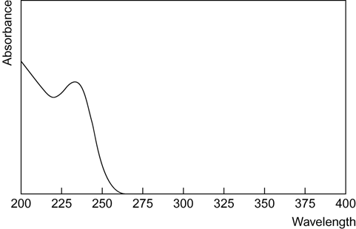
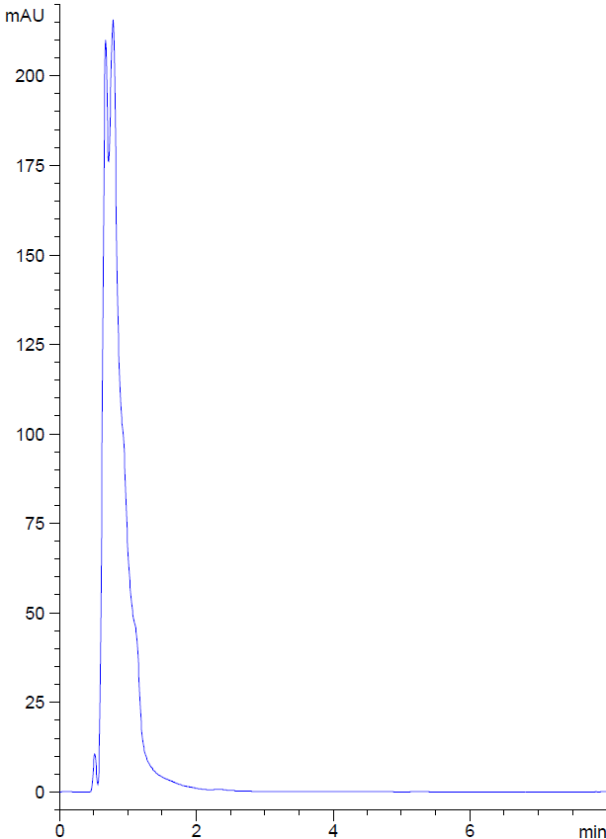
Selectivity and specificity
a)
b)
Fig 3. Spectra of Metformin in 236 nm(a) and HPLC-UV chromatogram of blank human plasma (b)

Slide 20
Robustness
Small changes in mobile phase organic strength
and in pH by ± 2% have no significant effect on chromatographic resolution.

Slide 21
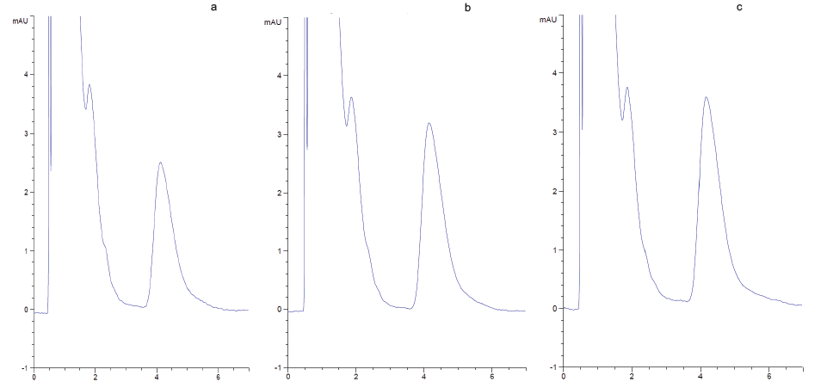
Metformin in Plasma- Data Examples
The method was used to determined metformin concentration in plasma samples from 20 healthy volunteers, after oral administration of a tablet containing 850 mg of metformin.
5 samples analysed in 20 minutes
For research use only. Not for use in diagnostic procedure.
Fig. 4. HPLC-UV chromatograms of plasma sample from a healthy volunteer a- 1 h (c=1322.4 ng/ml) b- 2 h (c=1708.1ng/ml) c- 3 h (c=1873.4ng/ml) after oral administration 850 mg of metformin.

Slide 22
Application in Pharmacokinetics and Bioequivalence Studies
Fig 5. Mean plasma concentrations of metformin (ng/ml) versus time (hr) profile for 20 volunteers after administration of Metforminë Profarma Sh.a 850 mg Tablets and Glucophage® 850 mg Tablets.

Slide 23
Conclusions
Method was simple,
rapid
selective
accurate
use conventional column
comply the purpose (study of BE from plasmatic data )

Slide 24
Acknowledgements

Slide 25
THANK YOU FOR YOUR ATTENTION !

